Slide 1


Building a Web App for Data Exploration with Smart Mapping
Kristian Ekenes
2018 Esri DEVSummit Conference | Palm Springs, CA

Slide 2
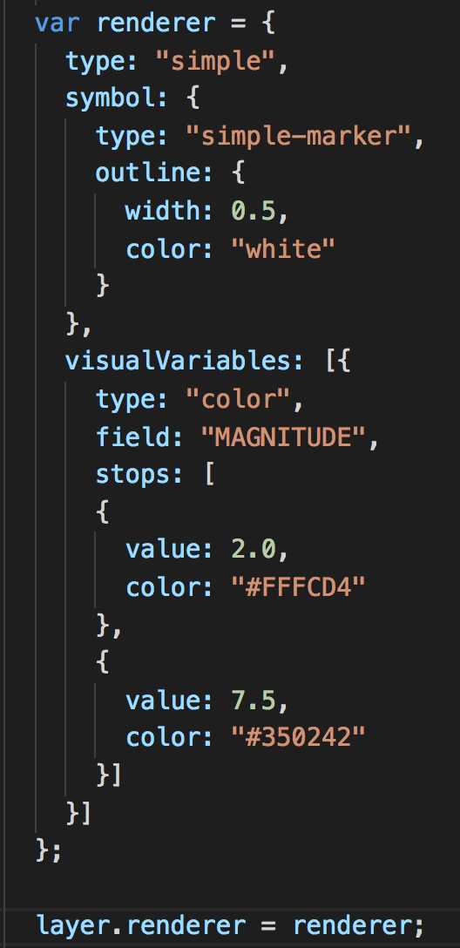
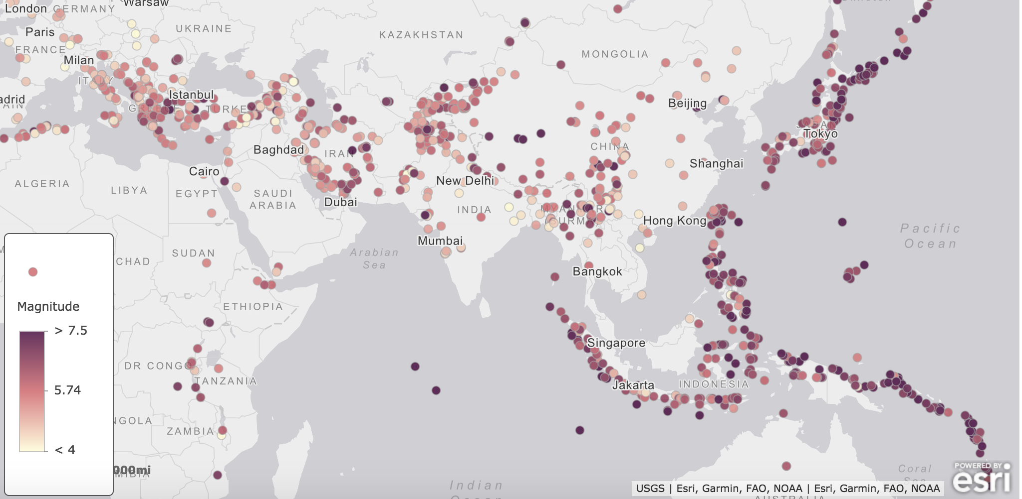

Visualization in the ArcGIS API for JavaScript
FeatureLayer/SceneLayer/MapImageLayer/CSVLayer
renderer
visual variables
Visualization
is hard

Slide 3
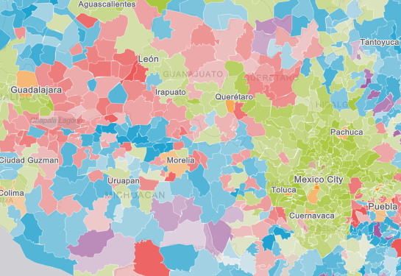
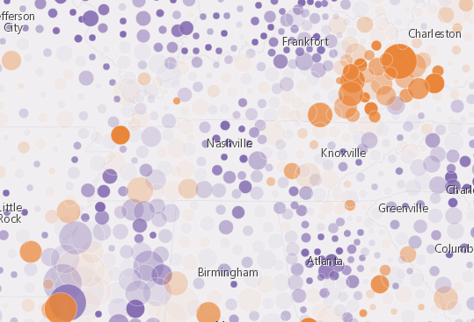
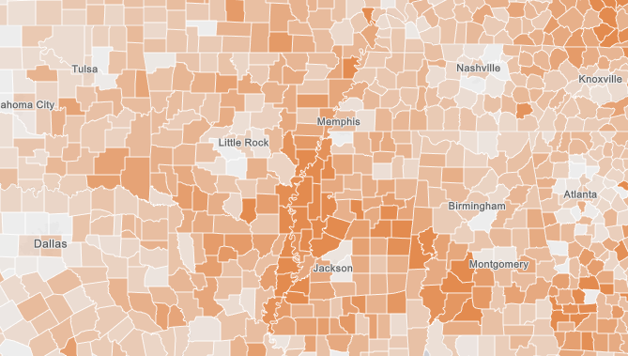
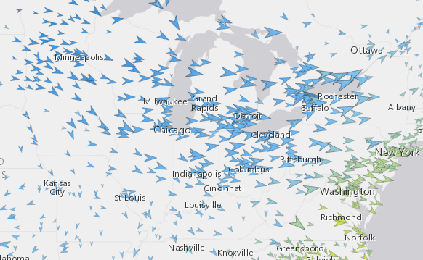
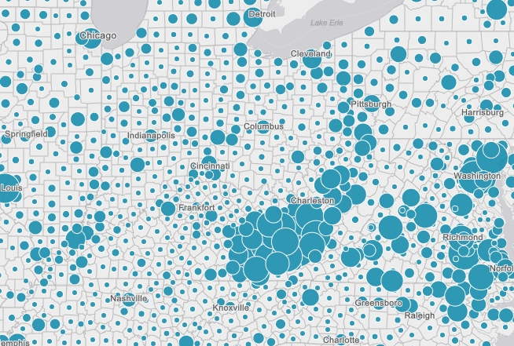
Smart Mapping

Slide 4
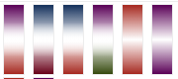
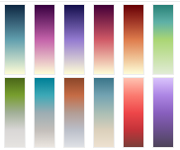
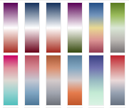
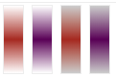
Color schemes and themes
Extremes
High to low
Above and below
Centered on

Slide 5
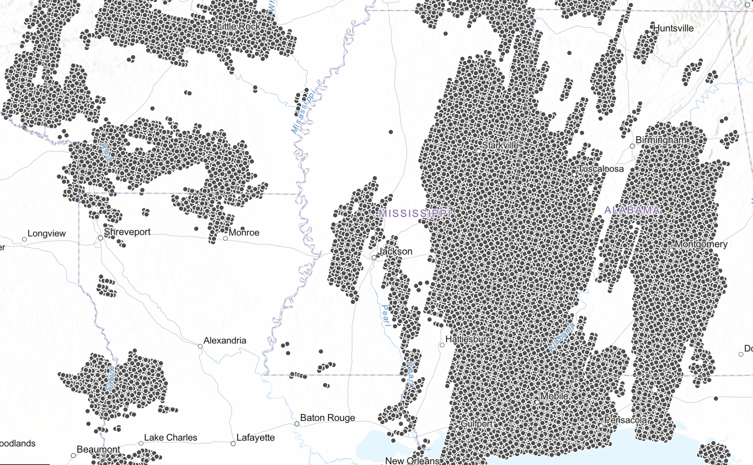
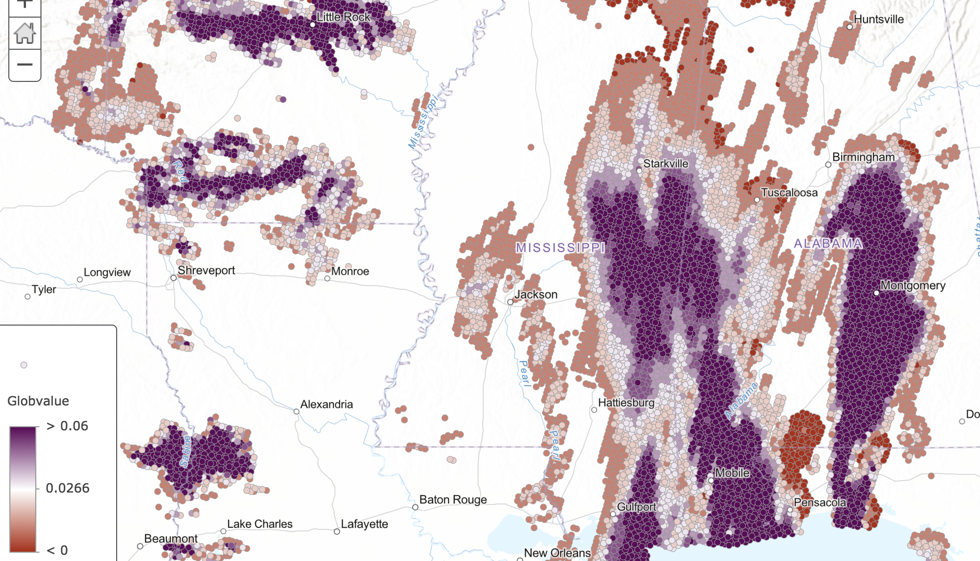
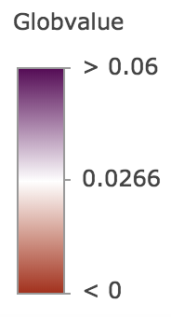
Smart Mapping Flow
DATA
FeatureLayer
CSVLayer
SceneLayer
MapImageLayer
Other sources…
Renderer
basemap
field/expression
theme
other options...
Renderer
creator
(Smart Mapping)
Layer
query data stats
get optimal color scheme
map data values to colors

Slide 6

Sample Apps
Election data exploration
Ecological Marine Units (3D)
Other samples…

Slide 7
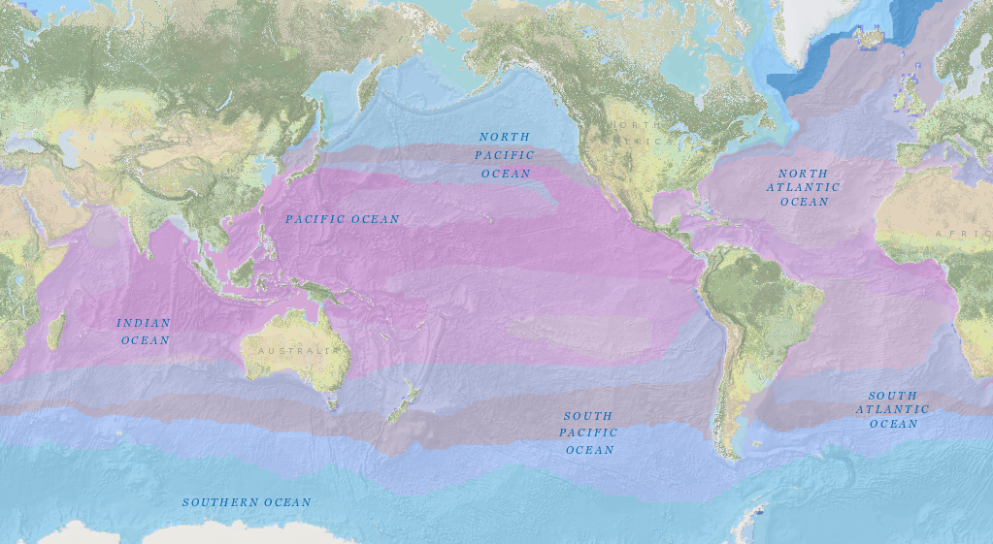
3D Smart mapping

Slide 8
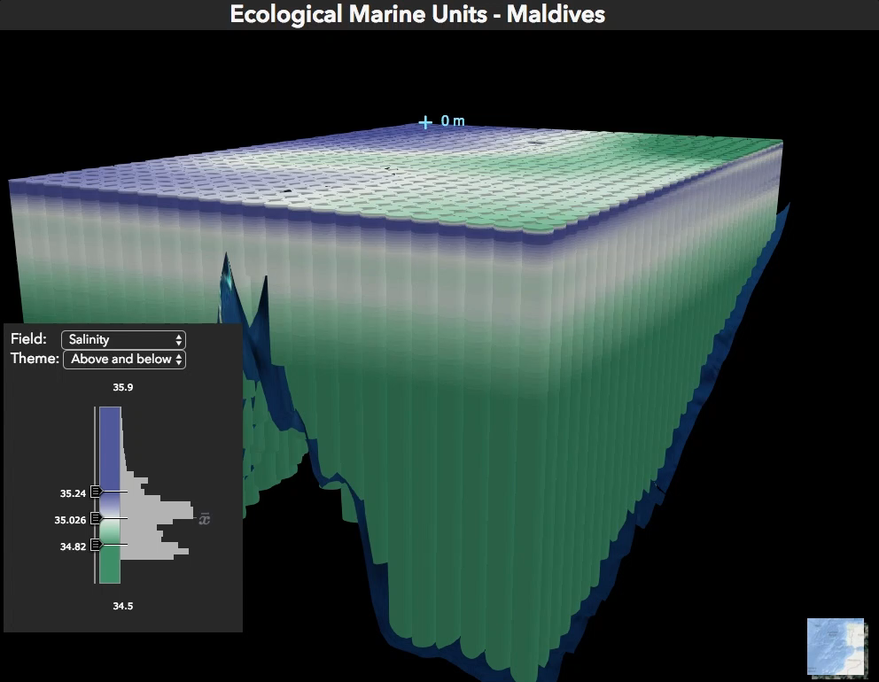
3D Smart mapping

Slide 9
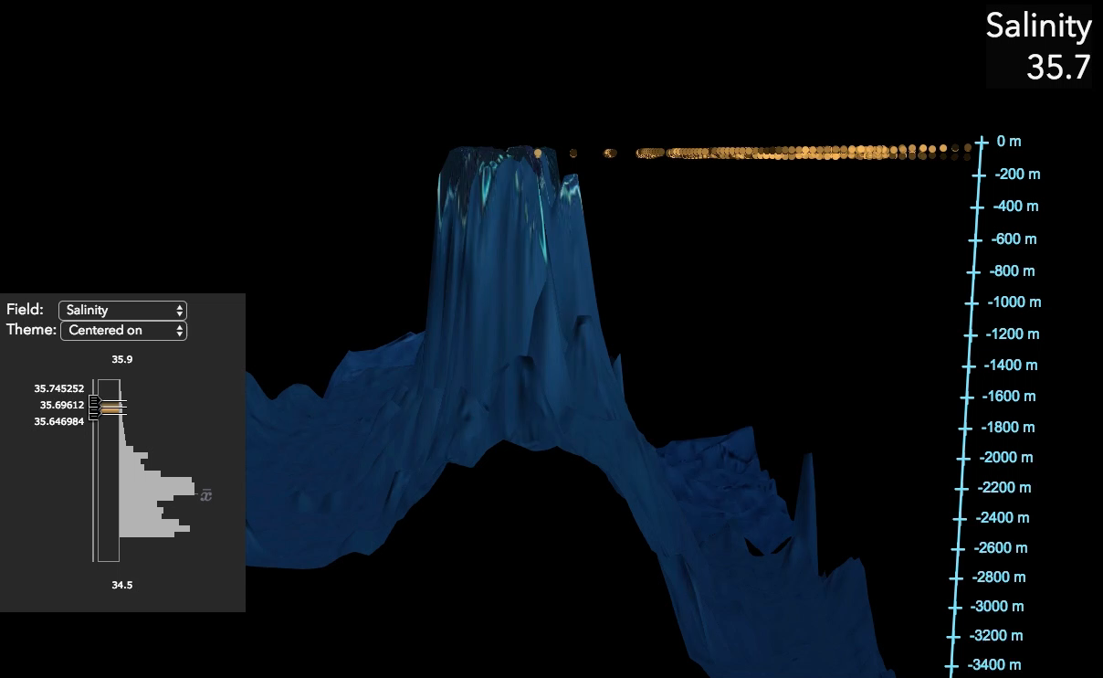
3D Smart mapping

Slide 10
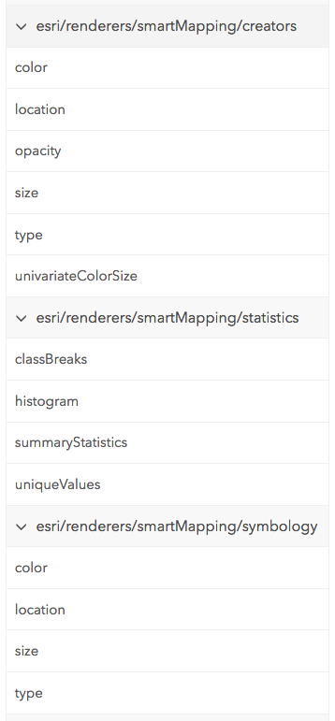
Resources
Documentation
https://developers.arcgis.com/javascript/latest/guide/visualization-overview/index.html
Demos/samples
https://github.com/ekenes/conferences/tree/master/ds-2018/smart-mapping
https://developers.arcgis.com/javascript/latest/sample-code/index.html?search=generate

Slide 11
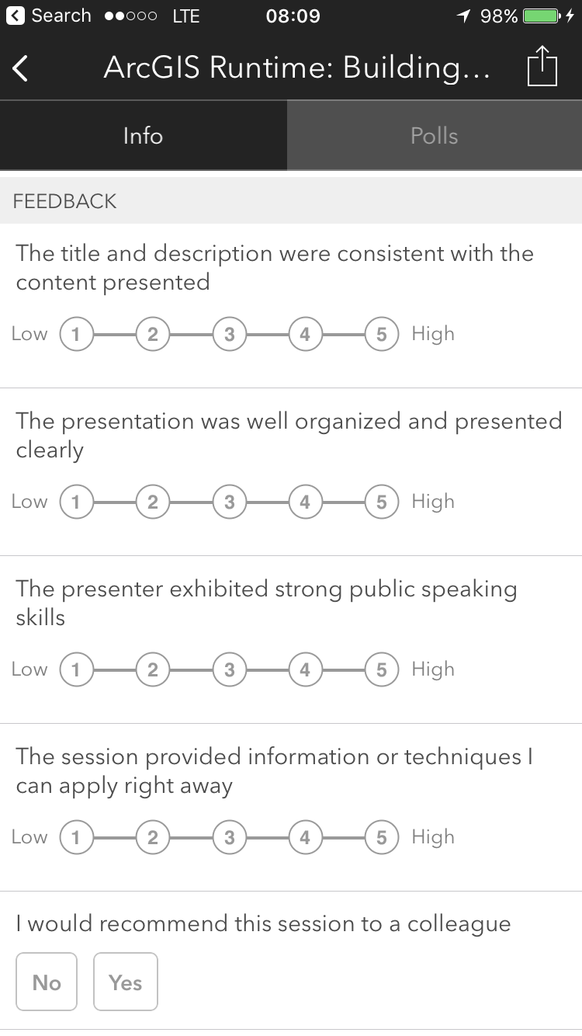
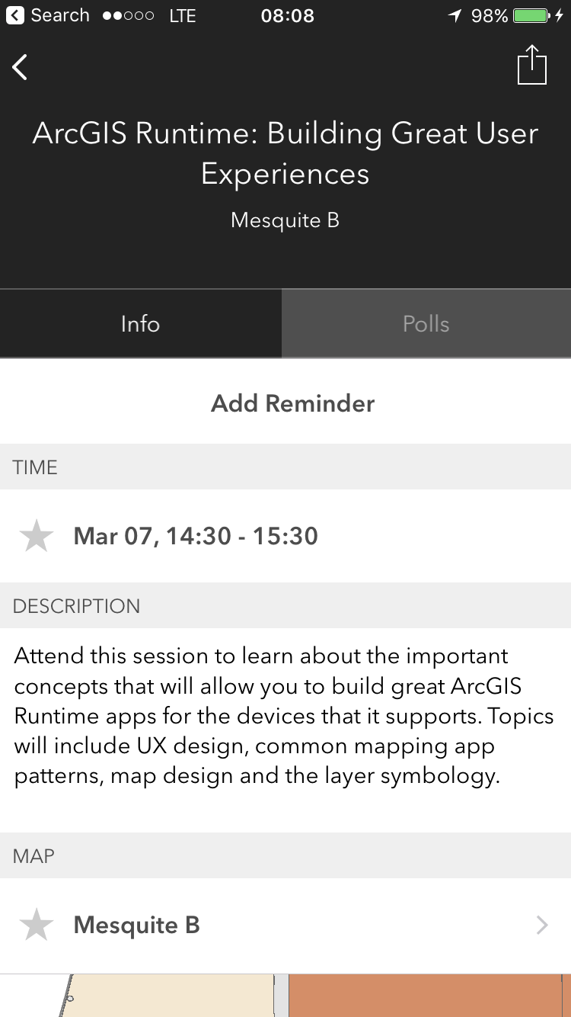
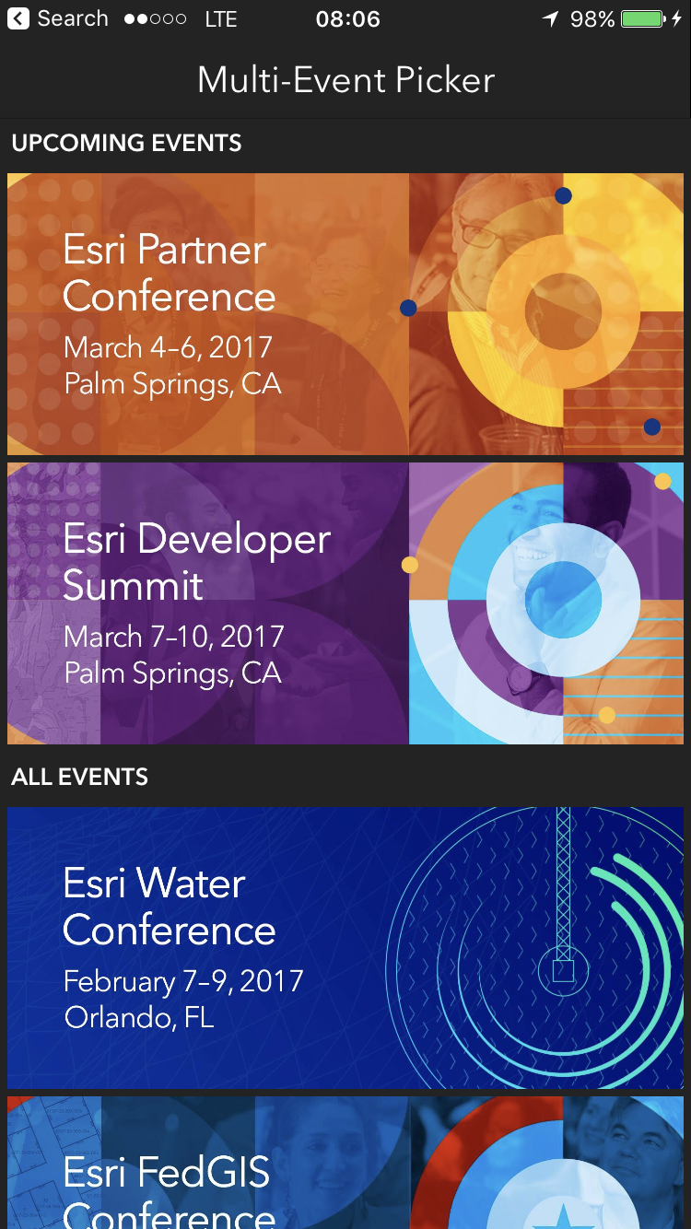
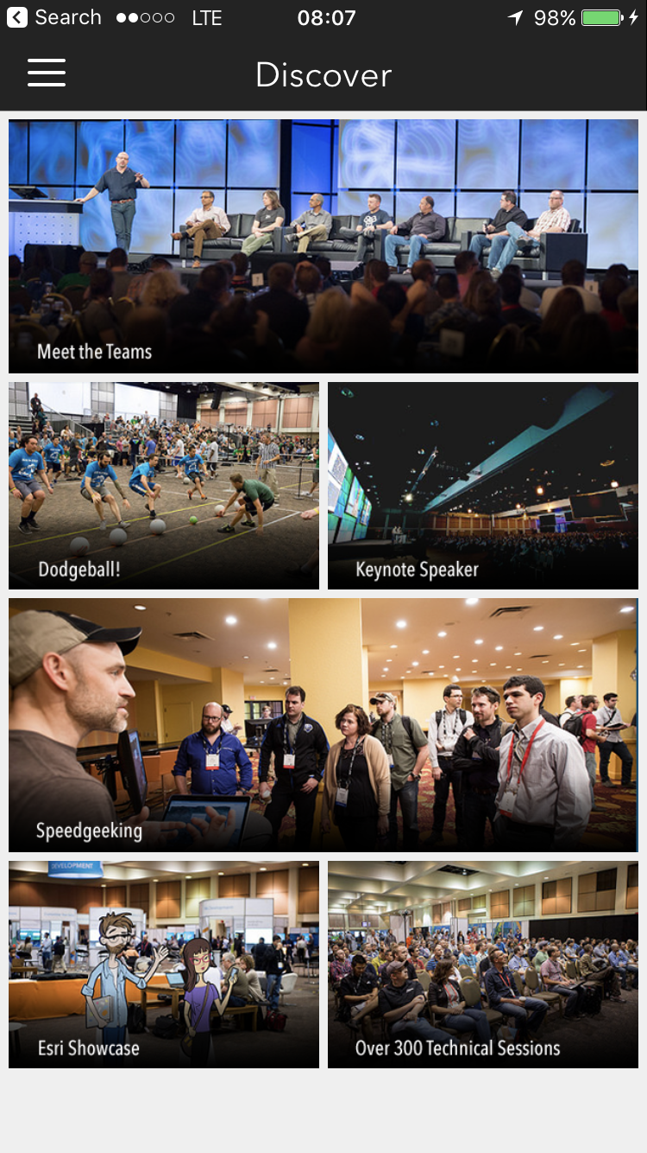
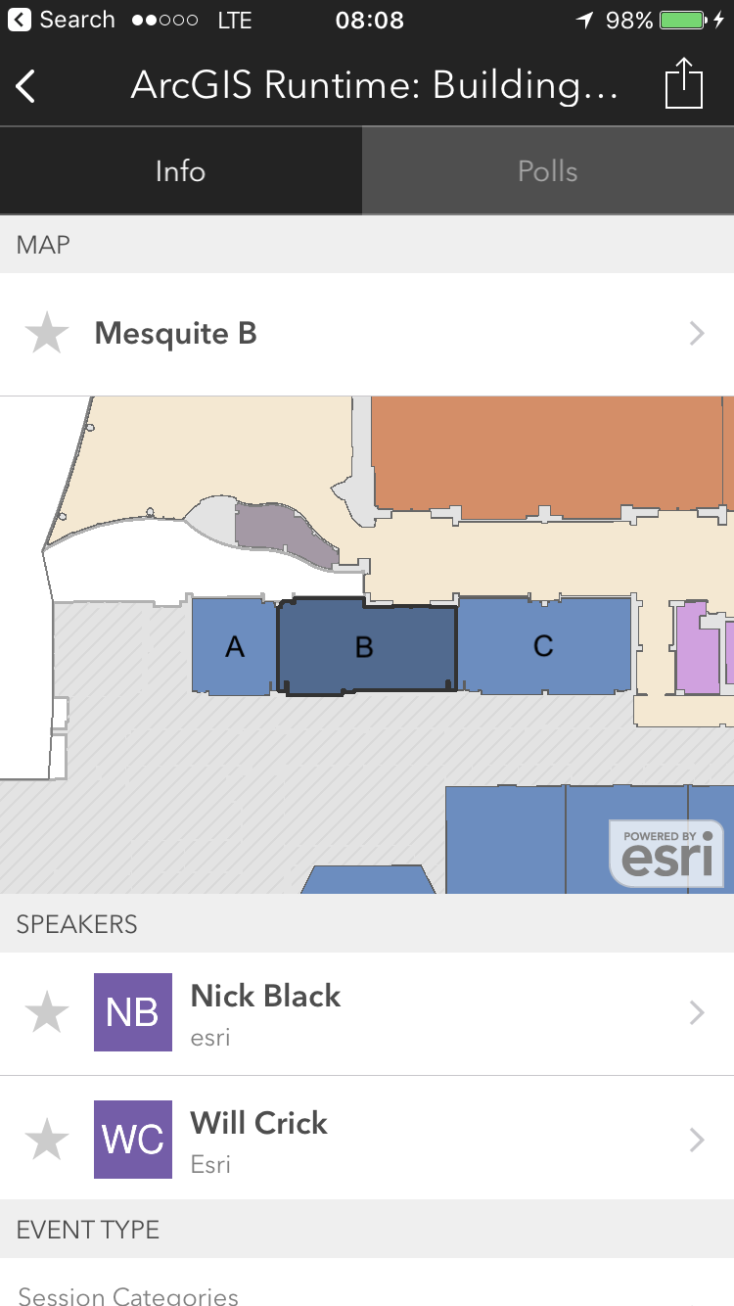
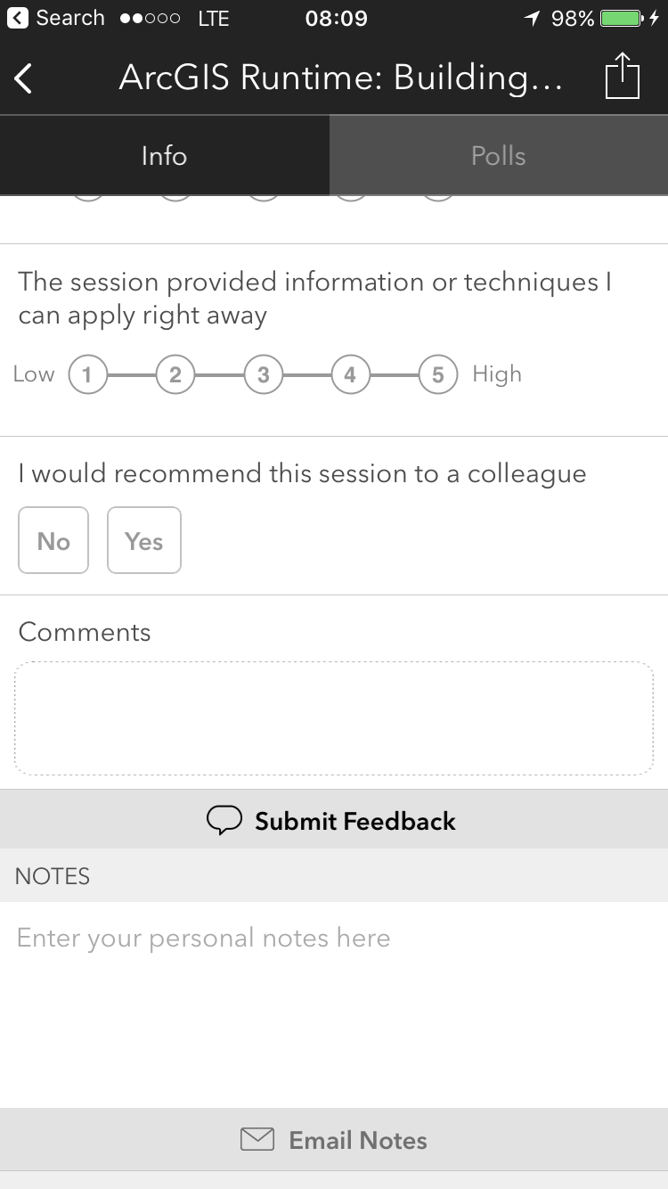
Please Take Our Survey!
Scroll down to the
“Feedback” section
Download the Esri Events app
and go to DevSummit
Select the session you attended
Complete Answers,
add a Comment,
and Select “Submit”

Slide 12



